Slide 1

ethical HACKING INTERNSHIP PROJECT SUBMISSION
Presented by : Vivek Kale

Slide 2
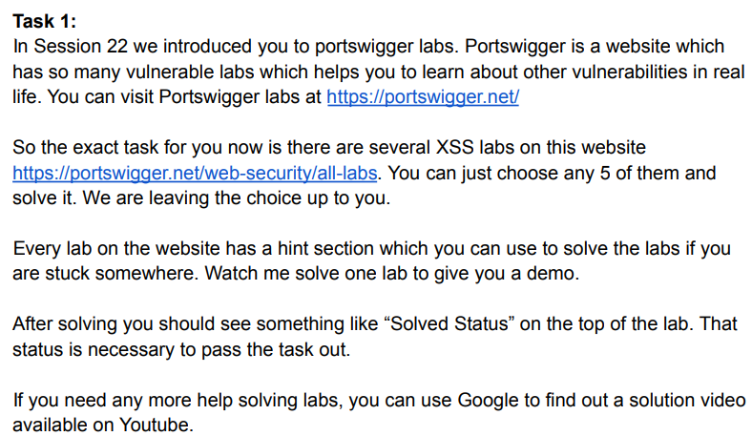
Project Problem Statement

Slide 3
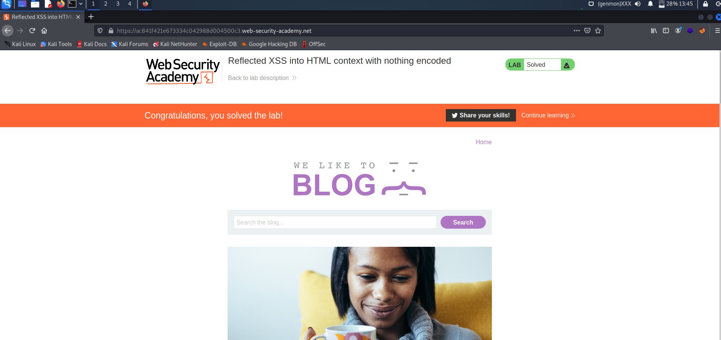
LAB 1 :-

Slide 4
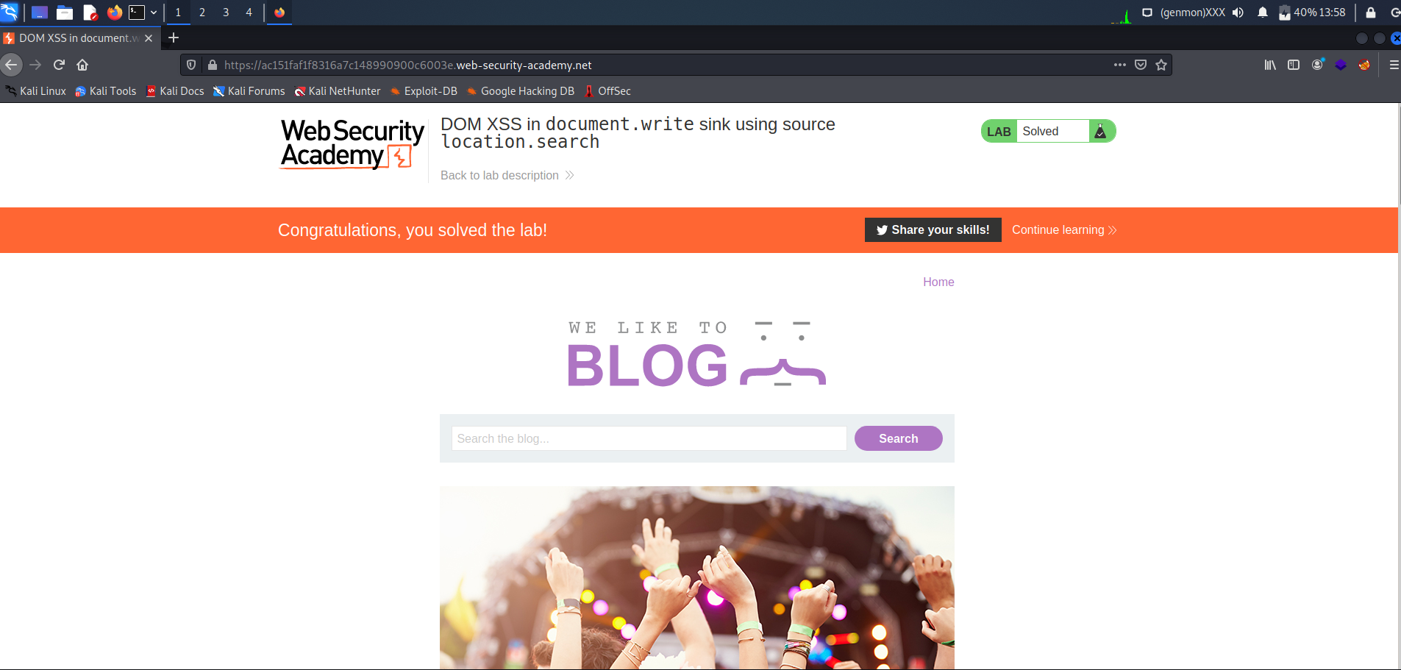
LAB 2 :-

Slide 5
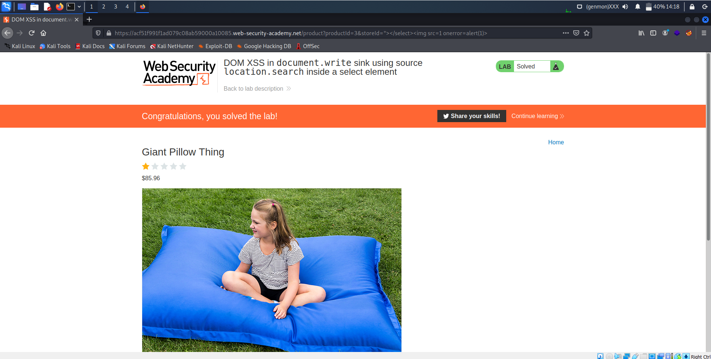
LAB 3 :-

Slide 6
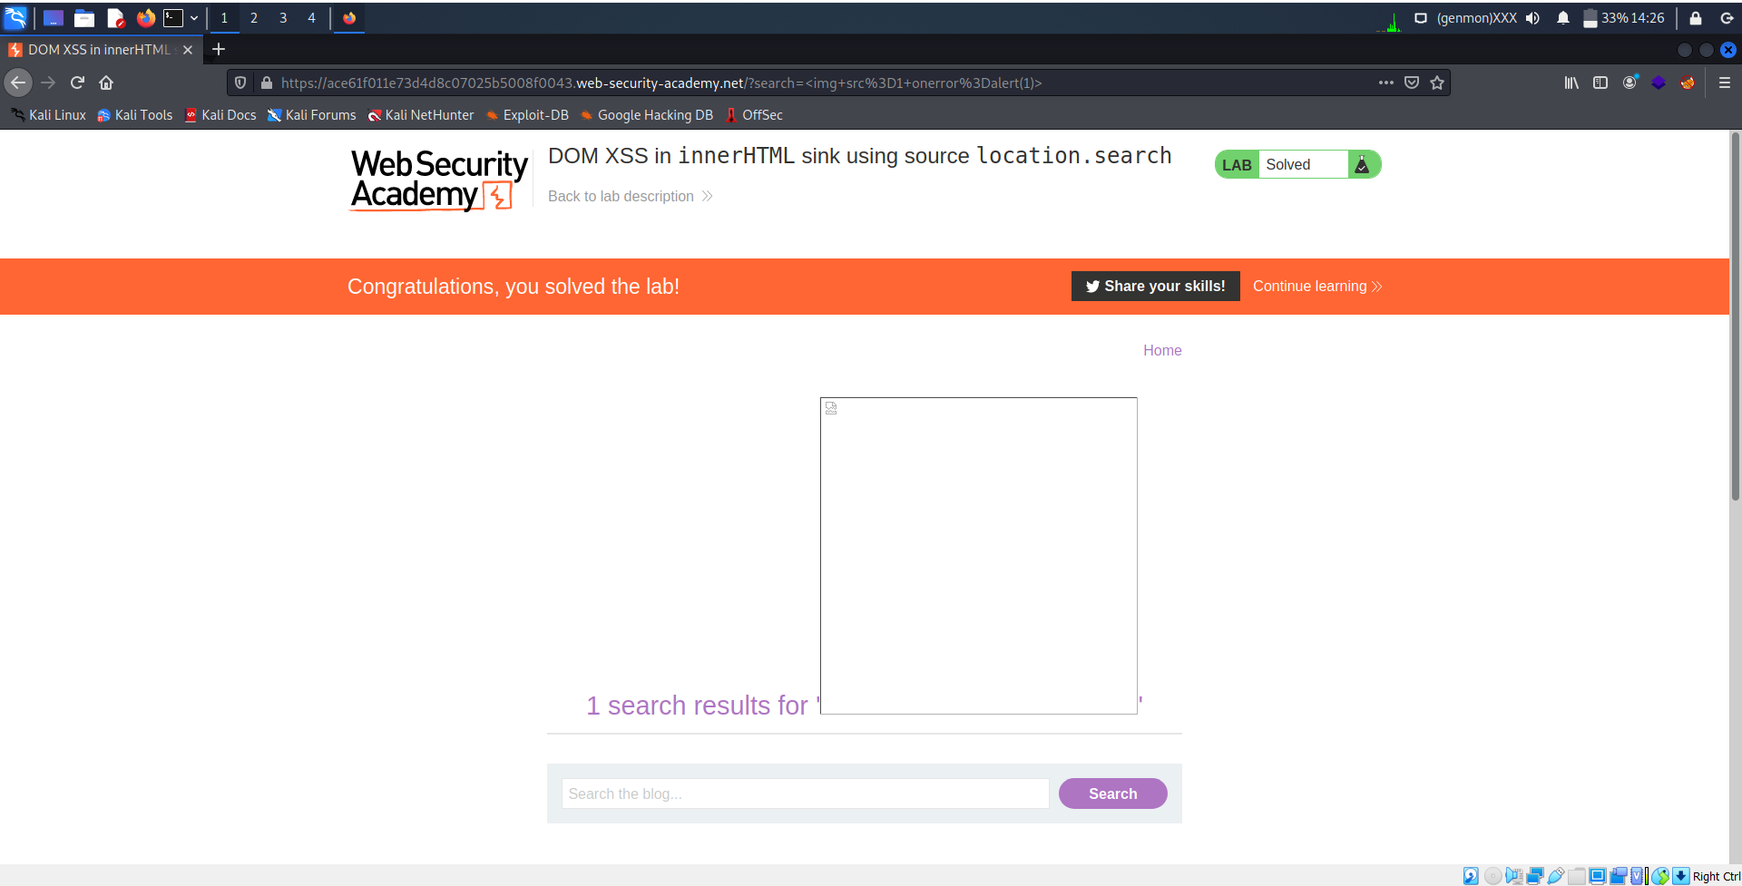
LAB 4 :-

Slide 7
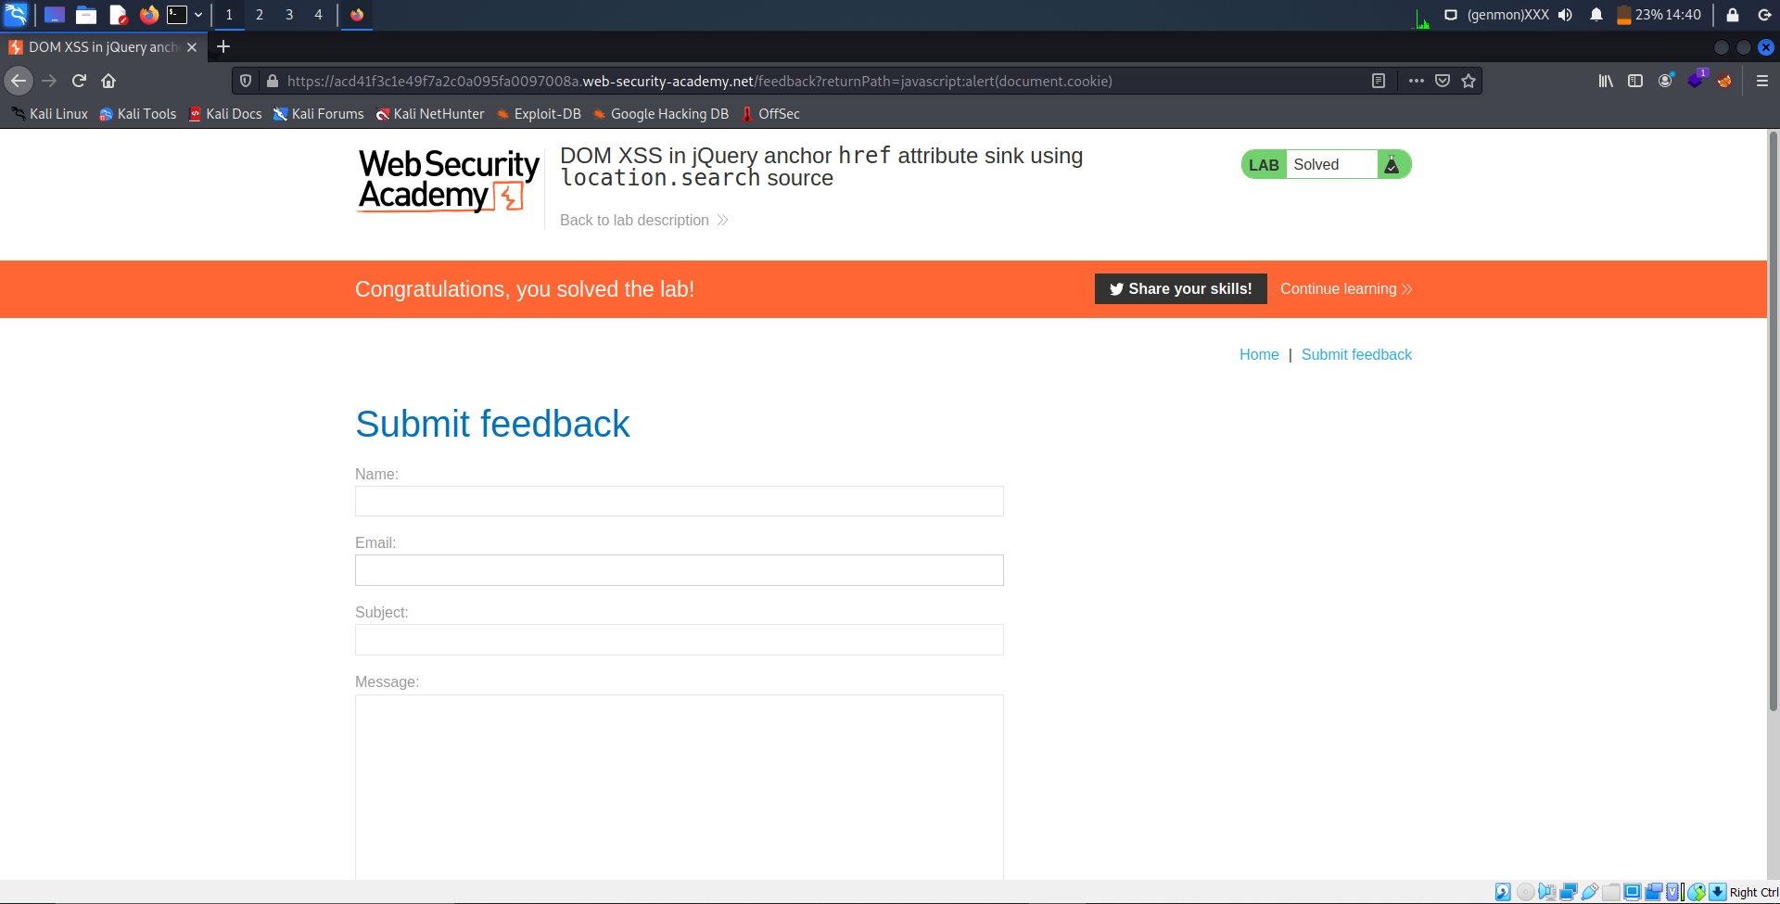
LAB 5 :-

Slide 8
THANK YOU
Here Task 1 is completed according to the guidelines specified by the INTERNSHIP-STUDIO.
All XSS LABS in the above slides are SOLVED.
-LAB 1
-LAB 2
-LAB 3
-LAB 4
-LAB 5
DOMAIN: https://portswigger.net/web-security/all-labs

